Slide 1

Review of the year 2021

Slide 2

January
Members told us of the books that enriched a difficult year

Slide 3

February
AGM, plus winners of the short story competition
together with a reading of the winning entry.

Slide 4

March
Peter Davis presented “The World of … “,
focusing on Iris Murdoch and Graham Greene.

Slide 5

April
The pen and the pandemic:
Alma Dorndorf told us how to survive lockdown in half a dozen books.

Slide 6
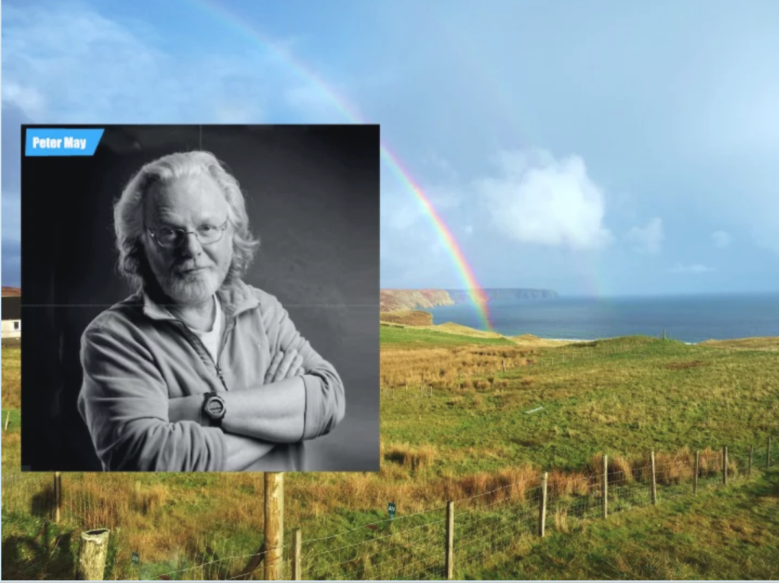
May
Crime Fiction and an introduction to the Peter May Trilogy
Presented by Terry Gifford

Slide 7
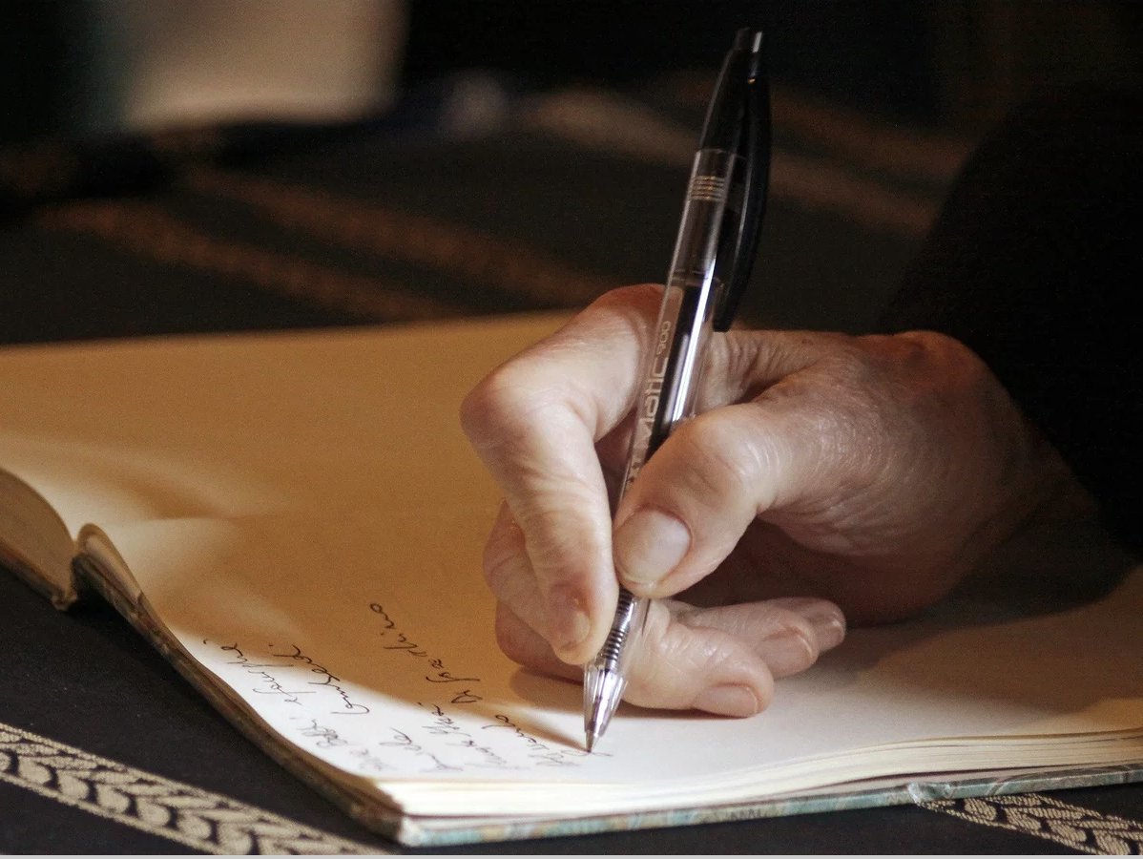
June
Memoirs: An introduction to the XBC writing competition.
Presented by Christopher North

Slide 8
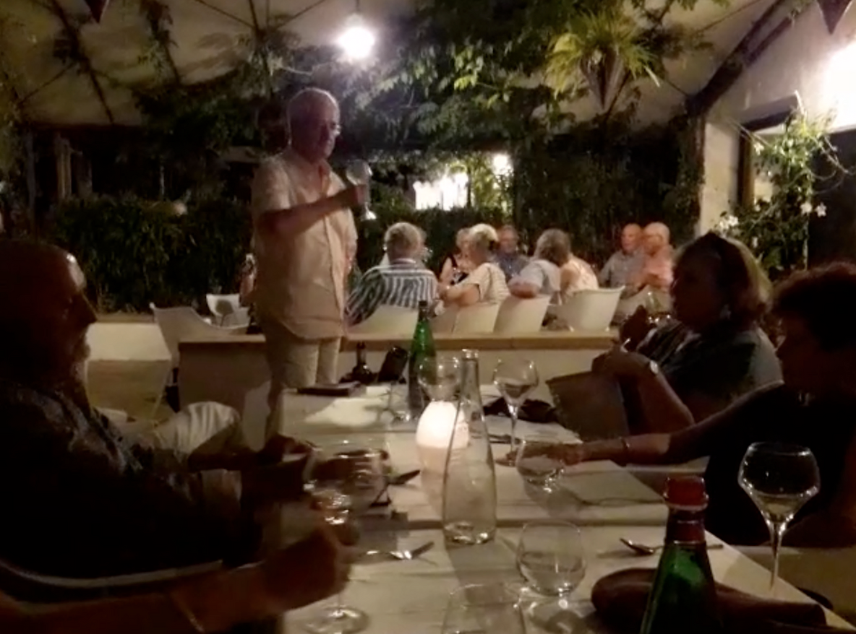
July
Summer supper
Held at Le Gourmand Restaurant

Slide 9
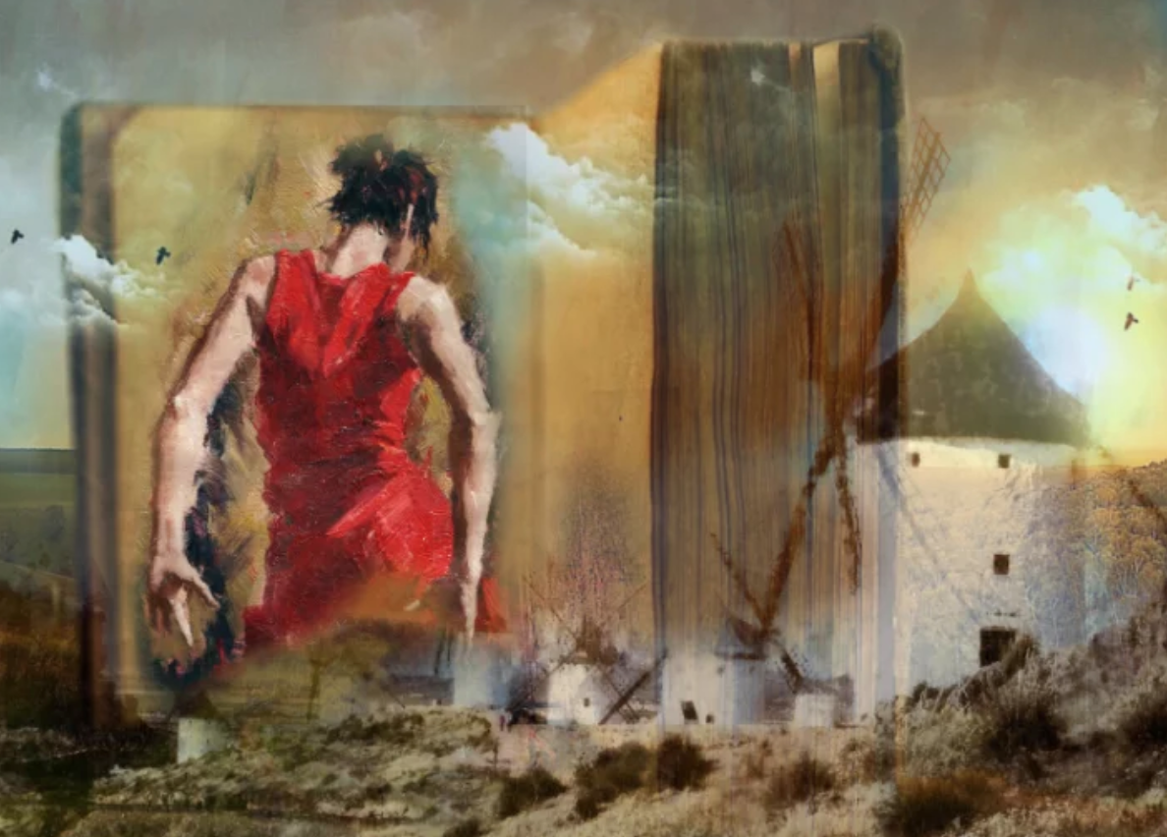
September
Unusual books about Spain
Introduced by Christopher North

Slide 10

October
Christopher North gave us the results of the memoir competition,
plus a reading of the winning entry by the author.

Slide 11

November
Racism in fiction.
With 5 minute intros by Huw Griffith, Alma Dorndorf, Tim Upton,
Jean Hilder and Rod Davis.

Slide 12
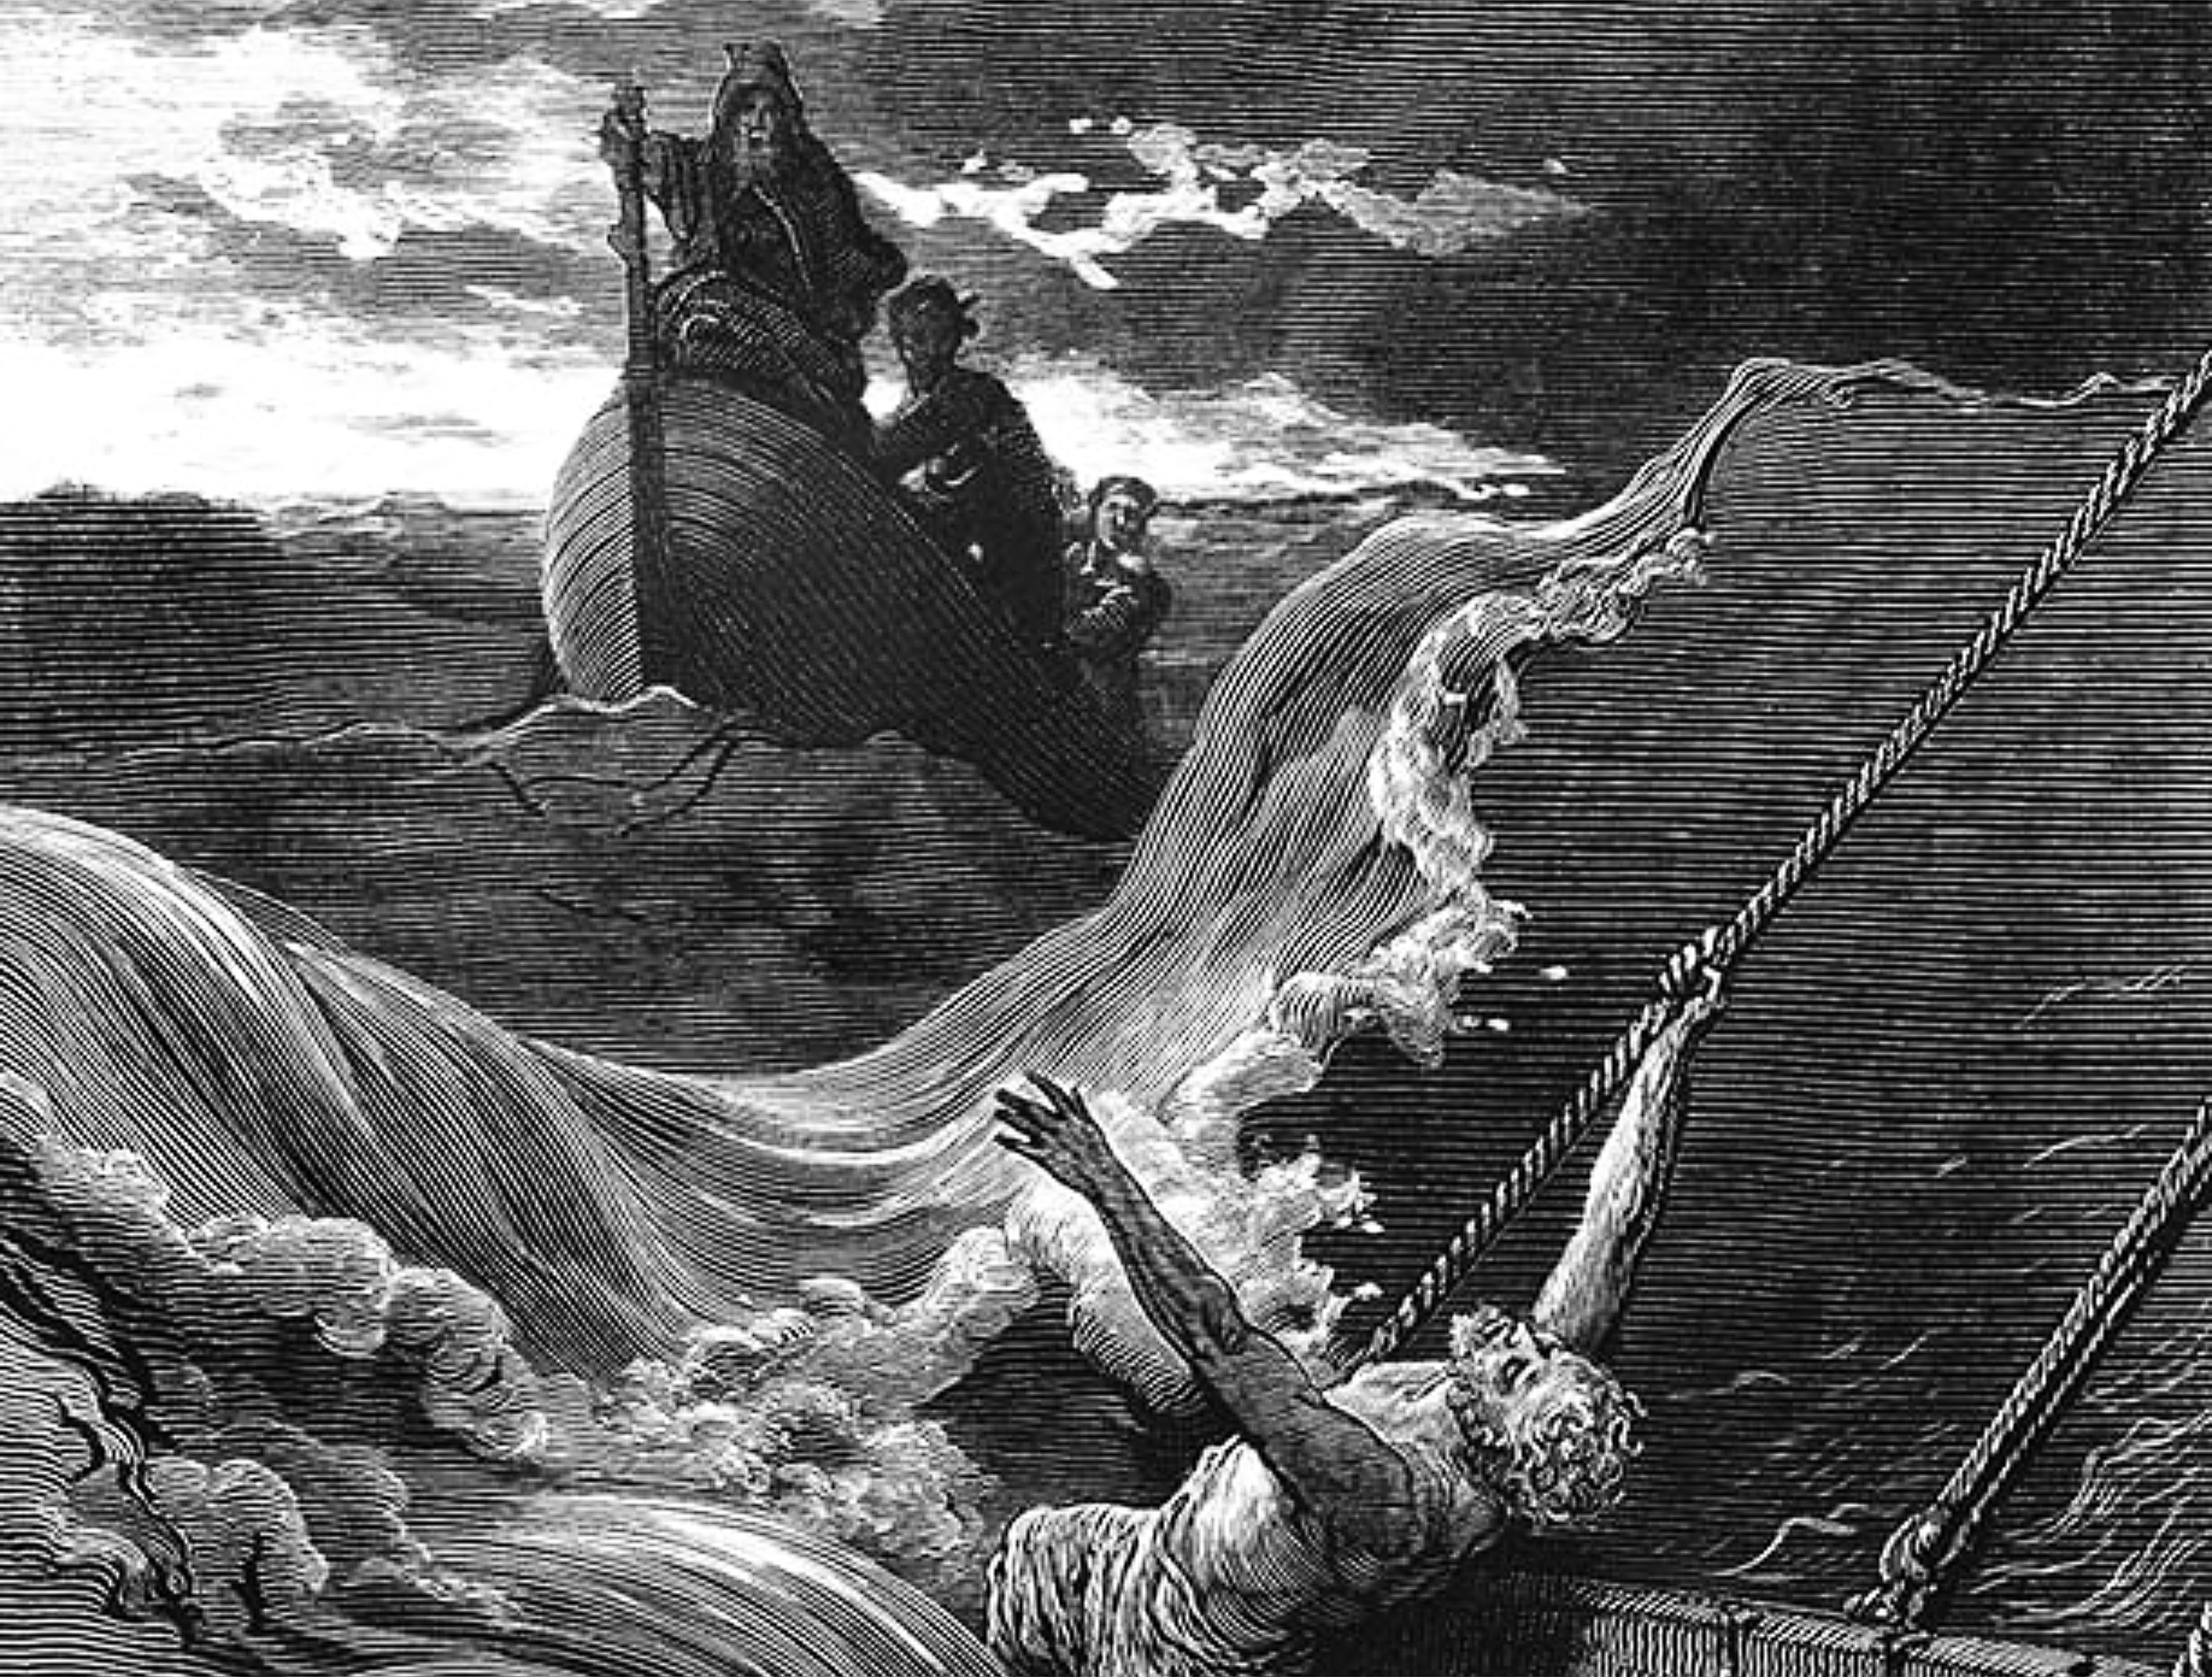
December
The Rime of the Ancient Mariner
An entertainment devised by Christopher North and read by XBC members
at La Seu Universtity, Benissa

